Slide 1

Social Media Awareness
&
Information Safety
Will McEllen, SFPC

Slide 2

Social Media has become a standard method of interaction in the modern world and provides us with wonderful ways to meet new friends and maintain links with those we already have. It allows us to quickly and easily share ideas, thoughts, images, and information with people around the globe in a fraction of a second.
NOW WITH MORE CATS THAN EVER!
However, the same things that make it such an amazing tool have also created a vast new arena in which less than desirable people, such as trolls, stalkers and cyber-thieves, can operate with minimal risk of exposure. Having a proper understanding of Social Media and how we interact with it is an essential survival skill for anyone with an internet connection.

Slide 3
Definitions and Terms
Doxing or Doxxing: to search for and publish private or identifying information about a particular individual on the internet, typically with malicious intent.
Spear Phishing: a targeted e-mail that appears to be from an individual or business that the recipient knows. The Phisher may use the recipient’s personal details in order to make the e-mail appear to be legitimate.
Open Source Intelligence: information collected from publicly available sources.
Six Degrees of Separation: the theory that every individual can be linked to any other person through a chain of no more than 5 acquaintances.
Watering Hole: a computer attack strategy in which the victim can be identified as belonging to a particular group (organization, industry, or region). In this attack, the attacker guesses or observes which websites the group or individual often uses and infects one or more of them with malware.

Slide 4

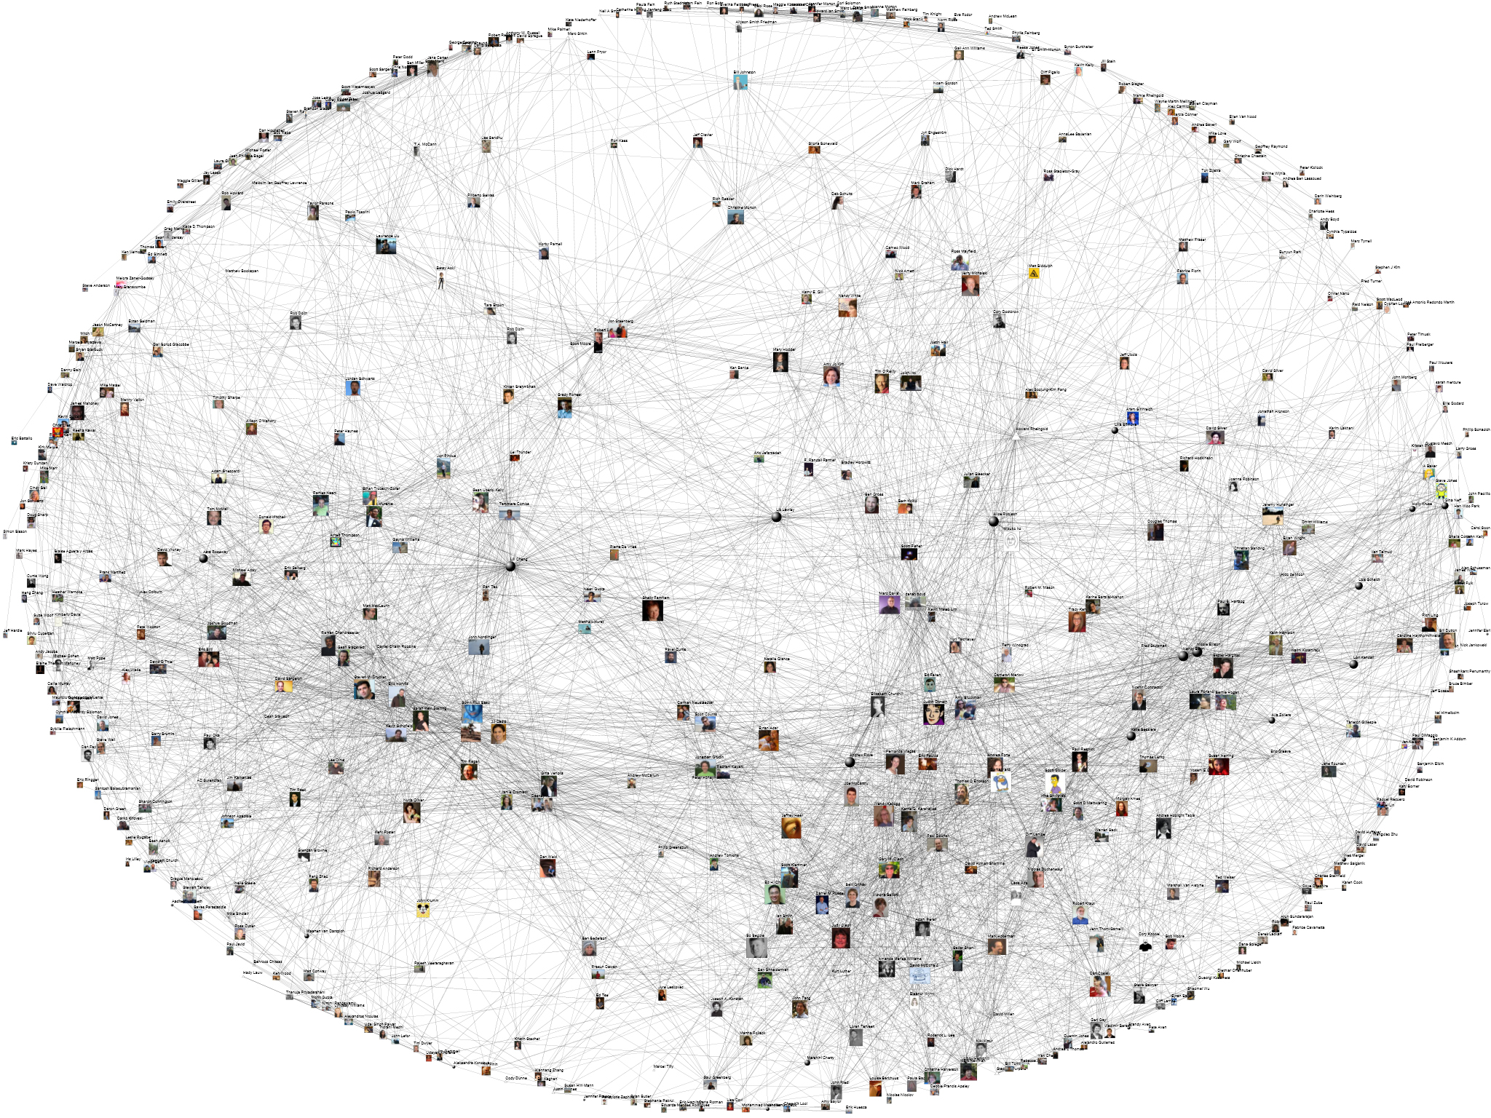

Definitions and Terms
Anatomy of a Social Media Network
Doxing or Doxxing: to search for and publish private or identifying information about a particular individual on the internet, typically with malicious intent.
A Social Media Network consists of a dedicated website or other application that enables users to communicate with each other by posting information, comments, messages, images, or other information.
Spear Phishing: a targeted e-mail that appears to be from an individual or business that the recipient knows. The Phisher may use the recipient’s personal details in order to make the e-mail appear to be legitimate.
Open Source Intelligence: information collected from publicly available sources.
Six Degrees of Separation: the theory that every individual can be linked to any other person through a chain of no more than 5 acquaintances.
Watering Hole: a computer attack strategy in which the victim can be identified as belonging to a particular group (organization, industry, or region). In this attack, the attacker guesses or observes which websites the group or individual often uses and infects one or more of them with malware.

Slide 5

Is this a Social Media Network?
Facebook
YES!
A Forum for Minecraft
YES!
OkCupid
YES!
I’ll friend you!
Tumblr
YES!
World of Warcraft
YES!
Pinterest
YES!

Slide 7

Safety tip -- marking ‘Antarctica’ as your home is pointless if you constantly RSVP for local events. Anyone can locate you if you hand out easy clues!

Slide 8
Kitty Break #1
Relaxxxxxxx….

Slide 9

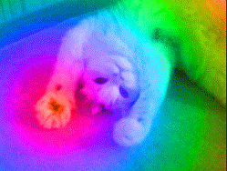
Ahhhhhh.....
That’s Better…
Shall We Continue?

Slide 10
Personally Identifiable Information (PII)
Information about an individual that identifies, links, relates, is unique to, describes an individual or can be used to positively identify them.
Sensitive PII: information which if lost or compromised could potentially result in harm or identity theft
Non-Sensitive PII: information whose loss or compromise would cause a risk considered to be minimal or non-existent
Social Security Number (full or truncated)
Mailing and Home Address
Driver’s License Number
Cell or Home Phone Number
Date of Birth
Citizenship
Place of Birth
Spouse’s Information
Medical Information
Mother’s Maiden Name
Fingerprints or Biometric Data
Personal E-mail Address

Slide 11
Personally Identifiable Information (PII)
Information about an individual that identifies, links, relates, is unique to, or describes an individual or can be used to positively identify them.
Non-Sensitive PII: information whose loss or compromise would cause a risk considered to be minimal or non-existent
Non-Sensitive does not necessarily mean unimportant.
Compiling multiple pieces of non-sensitive info can still reveal sensitive information.
It can also be used to link your actions and activities in order to create a digital map.
The information could be used to gain access to other sources leading to sensitive data.
For Example – Knowing an e-mail address or screen name could allow someone to spoof or mimic with a homograph. They could then contact your friends and gather information.
Which of the following is the real address?
USERNAME@HOTMAIL.COM USERNAME@H0TMAIL.COM USERNAME@HOTMA1L.COM
Notes:
*TP- using the information to gain access to other sources…. Faking an e-mail account and communicating with one of the individual’s friends. Ex. name@H0TMAIL.COM

Slide 12
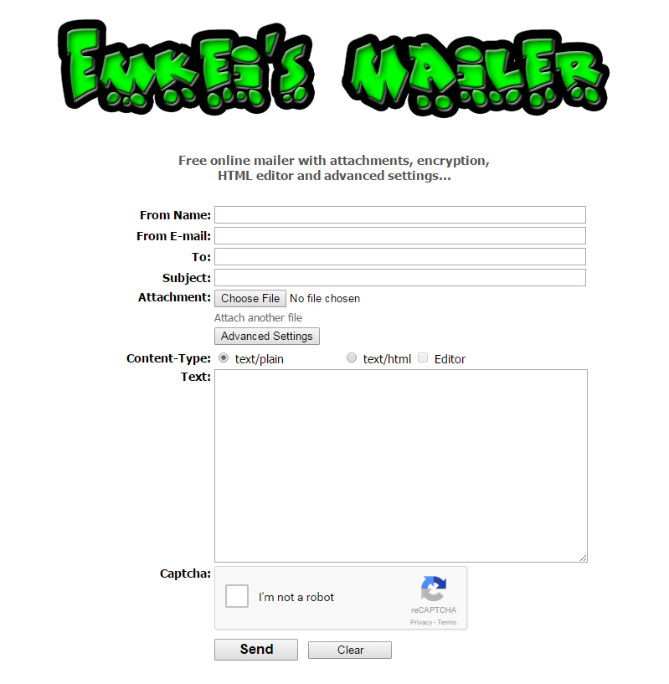
Spoofing
Spoofing does not require any specialized computer skills. On-line services are available for free. Anyone who can surf the web can spoof an e-mail.
More technically capable individuals may be able to create even more realistic spoofs in order to better bypass spam filters.

Slide 13
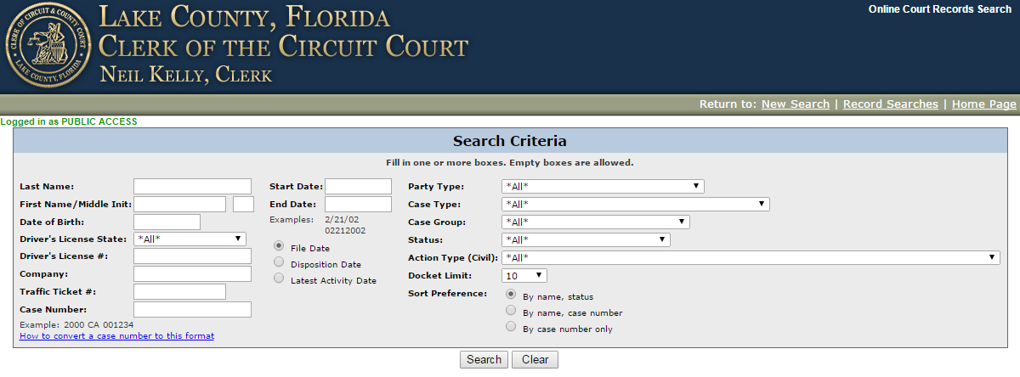
Gathering the Data – Open Source Information
Civil, Criminal, and Ticketing Databases
County Clerk Records
Volusia | http://app02.clerk.org/cr_inq/
Seminole | http://www.seminoleclerk.org/CriminalDocket/
Orange | http://myclerk.myorangeclerk.com/default.aspx
Osceola | https://online.osceolaclerk.org/BenchmarkWeb/Home.aspx/Search
Marion | http://casesearch.marioncountyclerk.org/
Lake | http://www.lakecountyclerk.org/record_searches/online_court_records/online_court_records.asp?

Slide 14
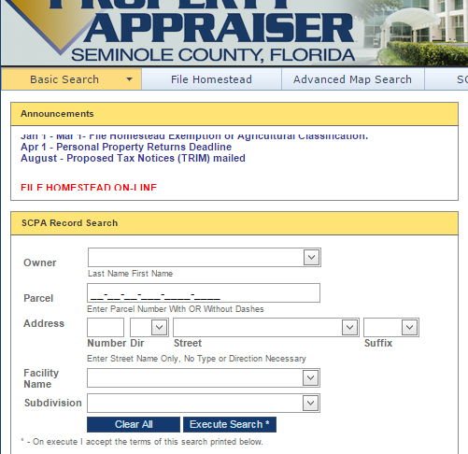
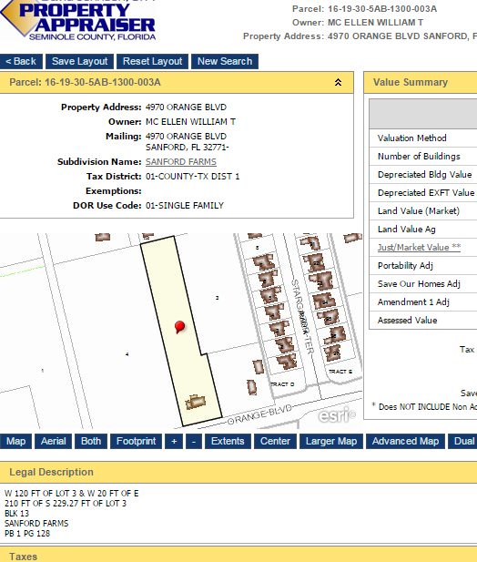
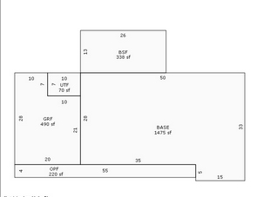

Gathering the Data – Open Source Information
Property Records
Meow?

Slide 15
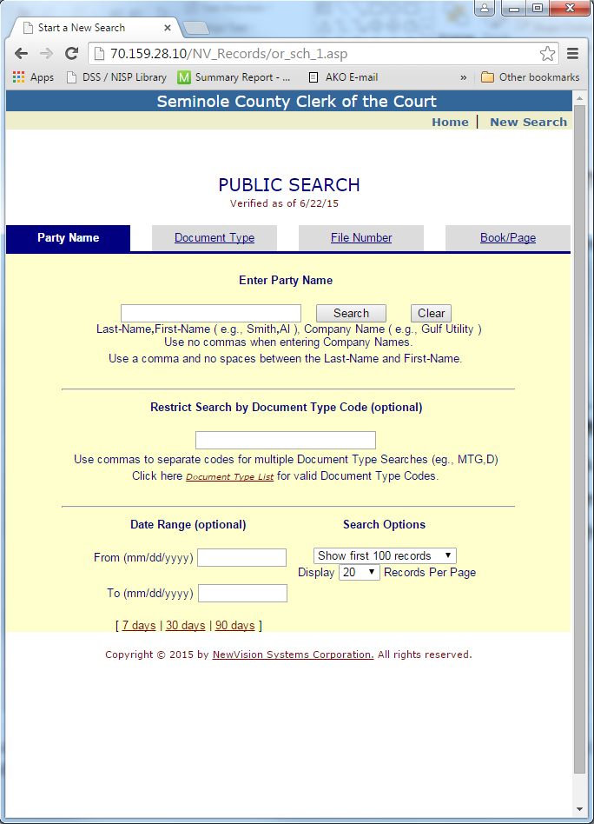
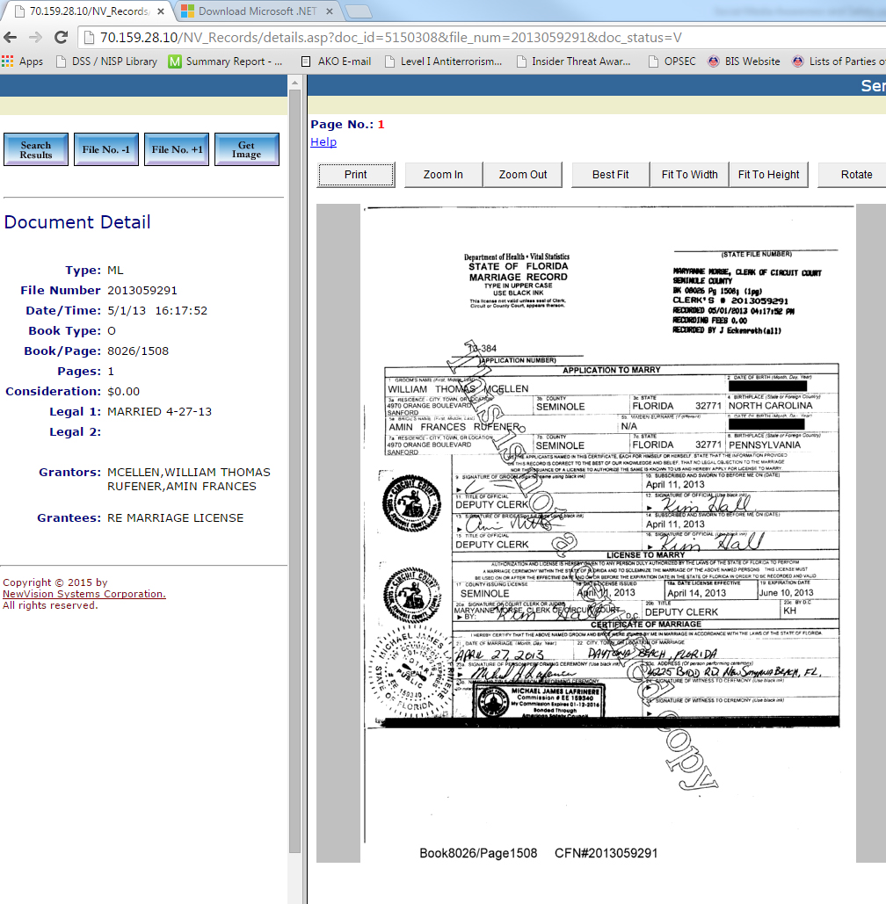
Gathering the Data – Open Source Information
Other Public Records

Slide 16
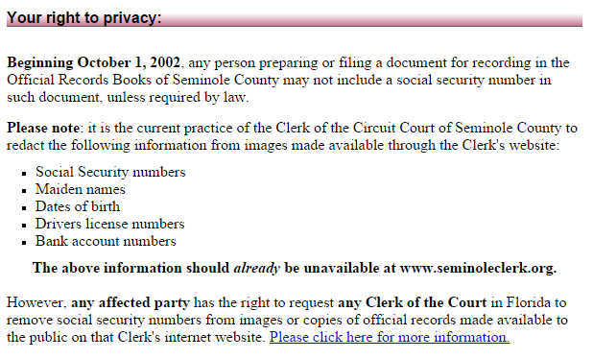
Gathering the Data – Open Source Information
Other Public Records
Protection for Public Records
Most county clerks have guidelines in place for redacting PII
It is recommended that you check any records associated with you or your family to ensure that they contain the minimal amount of information required
Note the phrase, “should already be unavailable.” – Better to check yours and let the clerk’s office know if any of your documents have exposed information

Slide 17
Kitty Break #2
Anyone Getting Hungry?

Slide 18

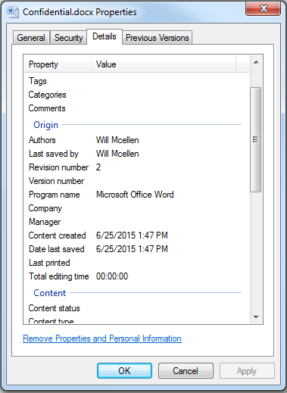
Gathering the Data
MetaData
Metadata is essentially data that describes other data. It is used to summarize basic information about data, which can make finding and working with particular instances of data easier. For example, author, date created, date modified and file size are examples of very basic document metadata. Having the ability to filter through that metadata makes it much easier for someone to locate a specific document.
It exists in some form with almost every file type. When electronically sending files it is essential that people ensure that they are aware of what additional data might be attached.
Simply right-clicking on a file and selecting the ‘Details’ tab will typically be enough to show you the information attached to a file. Windows will often allow you to remove personal information directly from this tab.

Slide 19
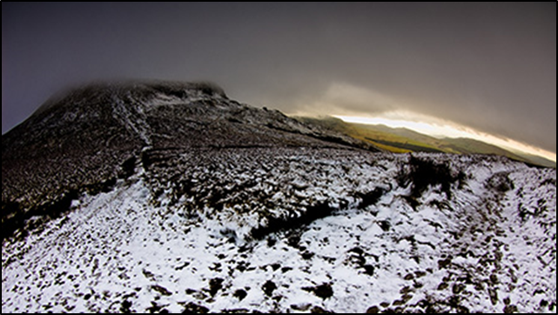
Gathering the Data
EXIF
One particular form of metadata that is in constant use is EXIF. If you’ve taken a cell phone photo, you’ve used EXIF.
EXIF stands for Exchangeable Image File and represents a form of data which is appended to a standard JPEG (image) file. This file contains various metadata and tags logged by the camera or smartphone at the time the image was taken. The data itself is not normally present when viewing the actual image.
Here are a few items that could potentially be captured in a camera’s EXIF file:
∎Time and date photo was taken ∎Camera make and model
∎Camera owner name ∎Camera’s serial number
∎Whether a flash was used ∎Zoom level
∎Camera mode ∎GPS coordinates
Sample Image

Slide 20
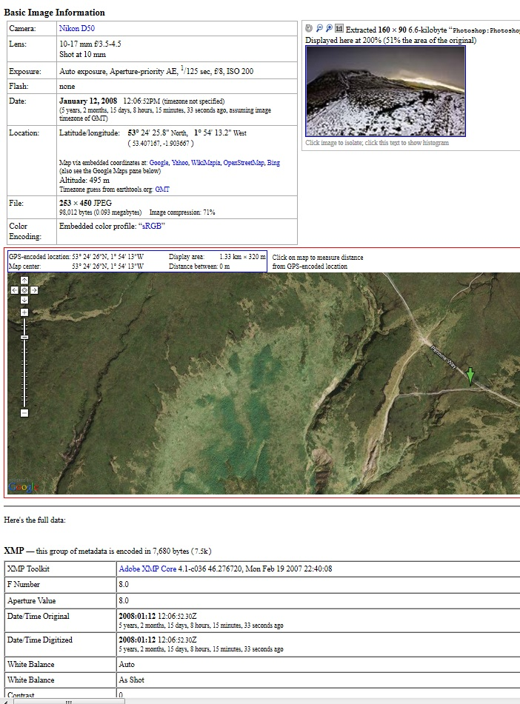
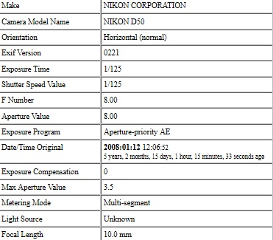
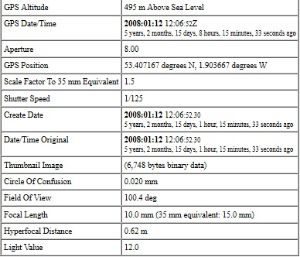
Gathering the Data
EXIF
To locate basic information through Windows you simply need to right click on the JPEG file and select ‘Properties’ and then ‘Details’.
There are also multiple EXIF viewers available through both commercial and freeware providers.
Most of these products display additional portions of the EXIF metadata along with automatic mapping capabilities.

Slide 21
Gathering the Data
EXIF
Examples of EXIF Use
∎In 2010, Adam Savage, co-host of the popular Mythbusters show, tweeted an image of his car while at his home. The photo contained EXIF information which identified the location of his home which had previously been kept confidential.
∎In 2012, John McAfee, former founder of McAfee and associates, eluded authorities who were seeking him for a murder charge. He was eventually located using the GPS coordinates found in a photo taken by Vice magazine.
∎In 2012, Higino Ochoa III, a hacker associated with the Anonymous-linked CabinCr3w was located and arrested after he posted images of his girlfriend on-line. Using the EXIF data attached to the photo, police identified the GPS location where the photos were taken along with the time and date. They were then able to use the information to confirm Ochoa’s identity and arrest him.

Slide 22
Gathering the Data
EXIF
Steps to take in order to avoid exposure of EXIF information-
The first step in mitigating EXIF risk is the awareness of its existence. Individuals should examine their cameras and smartphones to determine if they do in fact have the capability to record EXIF and what information is included in the EXIF.
The most effective option is to disable the GPS function on your phone to ensure that no location data is being recorded onto images.
Understand how websites treat photos. Some sites, like Facebook, typically strip away any EXIF information. Other sites, such as Flickr and Tumblr, maintain the integrity of the JPEG file.
Educate other individuals around you. A friend who takes a photo of you or a confidential location may also inadvertently reveal information that you don’t want publicly available.

Slide 23
…what other data is there?
Using the ideas behind 6 Degrees of Separation it is possible to use an individual’s friend list to start a 2nd or 3rd degree connection which leads back to the original person in order to gather supplemental information.
Remember that even information you delete can often still be found on the internet. Several database companies deliberately sift and store data which is then made available to the public, either for free or a small fee.
The comments of family, friends, co-workers, and even casual associates can be used to gather additional information.

Slide 24
How can all the information be used?
Elicitation Attempts:
A great way to gain access to important information is to demonstrate to someone that you already have insider knowledge.
Spearfishing:
It is very easy to generate a realistic e-mail when you already have records of supposedly confidential information.
Doxxing:
Maliciously placing large gatherings of information in a single, easily accessible spot can create greatly increased risks of identity theft or lead to other legal, business, or personal issues.
Personal Contacts/Stalking:
Details on your home, travel, friends, family, work, and play can allow others to easily track and find you or your loved ones. This can range from receiving harmless, but annoying, unwanted sales calls all the way to dangerous incidents created by a stalker identifying your whereabouts remotely.

Slide 25
Kitty Break #3
Don’t freak out!

Slide 26

Steps to Mitigate
Social Media Risks

Slide 27
Steps to Mitigate Social Media Risks
You can lessen (but not eliminate) the risks of Social Media by…
Taking the time to review your social posts and photos and not posting items which could reveal personally identifiable information.
Speaking with friends and family and advising them of the risks which could occur if they post certain information.
Locking down your accounts to prevent access by individual’s outside your immediate friends and family.
Don’t advertise that you have secrets or confidential information.

Slide 28




If Someone is Digging for Information
Internet Rule #1
Rocket Cat says, “Remember that sharing does not always equal caring.”
Know what information should not be shared, and be suspicious of people who seek such information. You can politely discourage conversation topics and deflect possible elicitations by:
Referring them to public sources
Ignoring any question or statement you think is improper or attempt to change the topic
Deflecting a question with one of your own or responding, “Why do you ask?”
Giving a nondescript answer or stating that you do not know
Stating that the information is not yours to give (safeguarding someone else’s secret)
Stating that you cannot discuss the matter or give a basic cover story

Slide 29
Safe Use of Usernames and Passwords
25 Most Popular
Passwords of 2014
123456
password
12345
12345678
qwerty
123456789
1234
baseball
dragon
football
1234567
monkey
letmein
abc123
111111
mustang
access
shadow
master
michael
superman
696969
123123
batman
trustno1
Don’t reuse usernames across multiple social media sites. A simple web search could potentially be used to link you.
Don’t use the same username as your e-mail address. Doing this greatly increases the chance of someone linking your information between sites/accounts.
Use a different username anytime there is a direct connection to your real name or contact info, such as when setting up a Skype account.
Use a strong password. Include upper-case, lower-case, numbers, and special characters. Try to use at least 8 characters or more.

Slide 30

Password Reset Challenge Questions
Answers to most Password Reset/Challenge Questions can be easily found out. Consider using alternate answers that only you would know.
You can also use a special method for entering your answers that allows you to use common answers in a unique way. One method would be to always move the first letter of each answer to the end of the word.
My favorite food is ‘icem’
Examples:
What is your favorite color? reeng (green)
What is your favorite breed of dog? ermang hephards (german shepherd)
In what city were you born? rlandoo (Orlando)

Slide 31

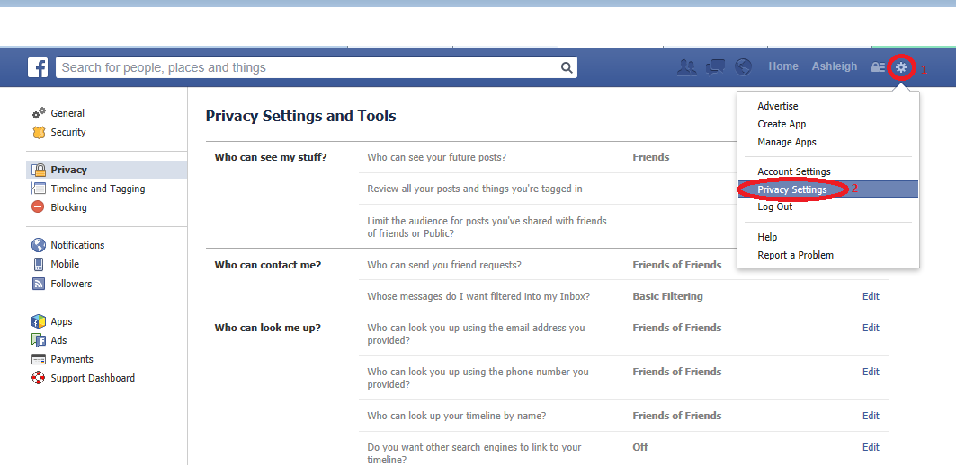
Facebook Privacy Settings:
Start by going to settings, then privacy settings and tools. From here you can view and change your settings, to include “Who can see my stuff?”, “Who can contact me?”, and “Who can look me up?”
As a general rule, it is a good idea to review your setting periodically in case Facebook changed any privacy settings. Review these options carefully, and keep in mind that any “public” settings will be searchable and potentially viewed by third parties who could use any posts or personal information against you.

Slide 32
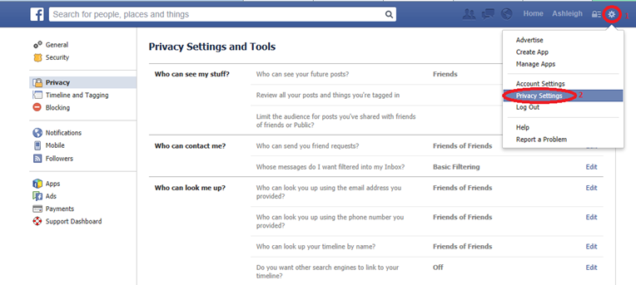
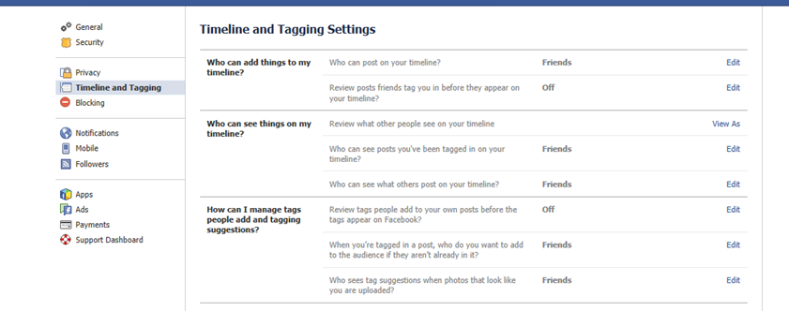
Controlling What Friends Post
Many Facebook users are unaware that there is an extra step to review what friends post to your wall, before they appear as a part of your profile. To set up this extra security precaution, just follow these steps:
Go into “Privacy Settings and Tools”, then to “Timeline and Tagging”, on the left-hand side bar.
Here, you can edit your settings to review and approve posts before they are added to your profile.

Slide 33

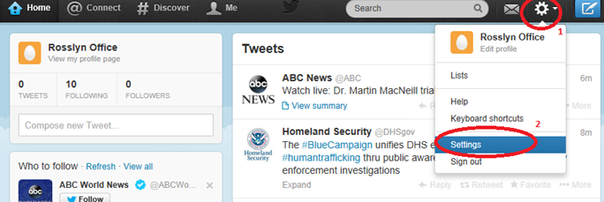
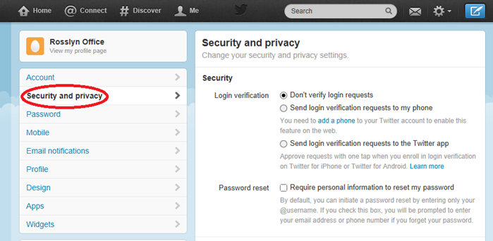
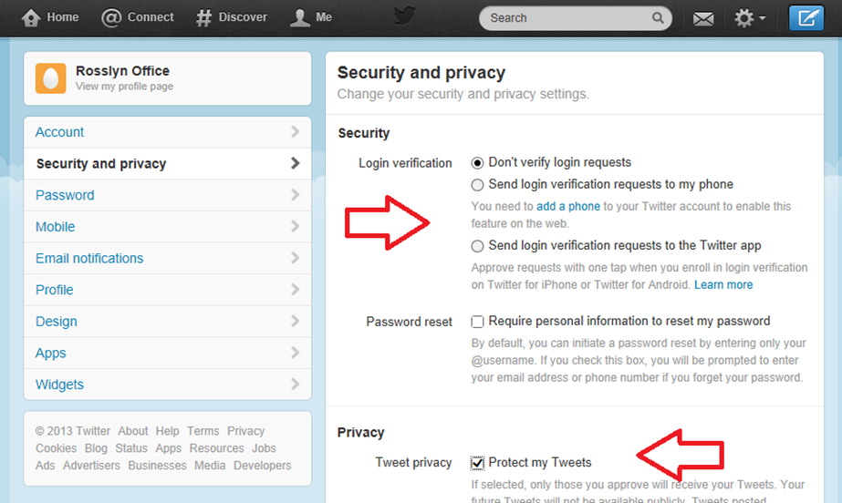
Security and Privacy on Twitter
To monitor and change your security and privacy settings, first navigate to the cog in the upper right corner of your profile, to the left of the compose tweet button. Next, go down the menu and select “Settings”.
Next, navigate to the left-hand side of the page to select “Security and Privacy”.
From here, you can review your security and privacy settings, to include login verification, and protecting your tweets. “Protecting” your tweets means that only those who you have confirmed to follow you can view your tweets, virtually creating a more private Twitter experience.

Slide 34
Sharing your Location in Tweets
Twitter also lets you control whether you share, or not share, your location from where you are sending your tweets. It is important to keep in mind that you may not know all of your followers and pinpointing your exact whereabouts in real-time may be a safety issue.
To select or unselect this option, you can go to the Security and Privacy settings page, scroll down to “Tweet Location” and “Add a location to my Tweets”. From here you can also delete all your location information from past tweets.
Another security option you can exercise on this page is to let others find you by your email address, or to unselect this option.

Slide 35
Other Personal Information
Another thing to consider when creating or maintaining your Twitter profile is to be cautious about what personal information you share. This includes contact information such as phone numbers and email addresses that internet criminals or SPAM bots could use against you.
Twitter automatically does NOT share your email address, but opportunities to share personal info include editing your bio as well as any individual tweet. You can review or edit your bio by selecting “Me” on the main navigation bar and then “Edit profile”.

Slide 36




REMEMBER!
Social Media sites are constantly updating their terms of service and page settings. Make sure you stay up to date with how each site stores and shares your information.

Slide 37
Don’t Forget…
How many people used to use a site like MySpace and then transitioned to Facebook?
Did you remove all of your information from the previous site?
Are there sites out there with your info that you can no longer access, e.g. Yahoo’s GeoCities?
How many dating or personals sites did you register for that could still be actively broadcasting your info?
Take the time to look up these old sites and remove whatever you can.

Slide 38

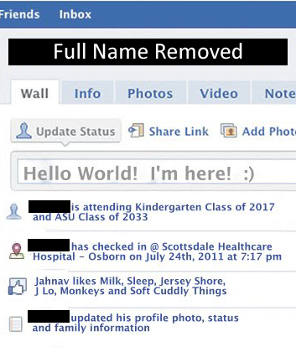


Remember that the Internet never forgets
Take a moment to imagine how connected the digital world will be 10 or 20 years from now
One Last Thought….
Social Media has steadily moved towards being the de facto method for broadcasting major life change announcements, such as births.
Birth announcements often contain a plethora of information that would normally be considered to be Sensitive PII.
Keep in mind that this information will continue to be easily accessible 18+ years later.
+
=

Slide 39
Additional Risks
There are many other internet and information system risks that could potentially affect you. As Social Media and the Internet of Things expands we will continue to see a further integration of these technologies into our everyday lives.
Taking the time to educate yourself, and keeping up to date with changing security issues, can help ensure the safety of you and your loved ones.

Slide 40
Resources for Social Media and Internet Safety
https://www.fbi.gov/about-us/investigate/counterintelligence/internet-social-networking-risks
http://www.LooksTooGoodToBeTrue.com
http://www.onguardonline.gov
https://www.us-cert.gov
http://www.ic3.gov
https://www.getsafeonline.org

Slide 41
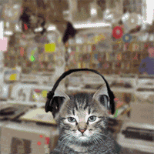
Questions?
Please Contact Your FSO

